Slide 1
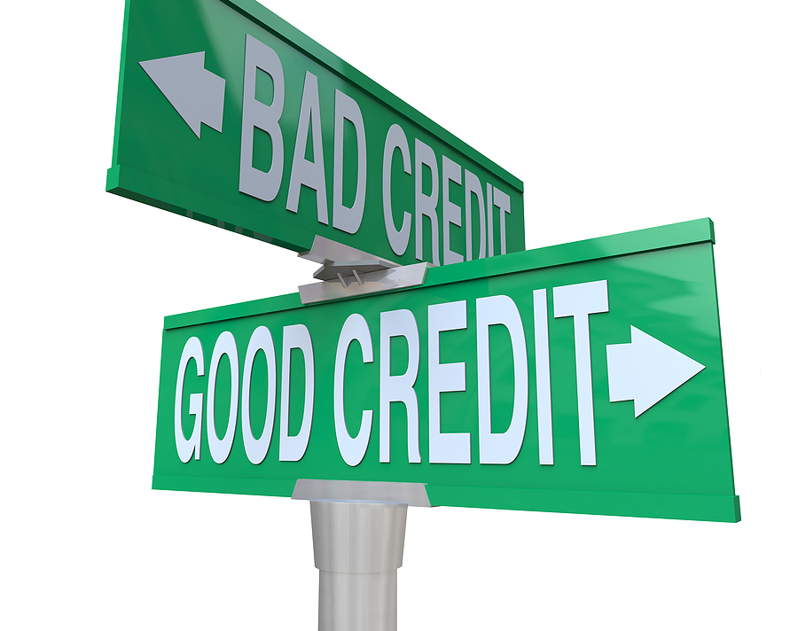
Micro Credit Defaulter
This Photo by Unknown author is licensed under CC BY-NC-ND.

Slide 2
Introduction

Slide 3
Introduction
A Microfinance Institution (MFI) is an organization that offers financial services to low income populations. MFS becomes very useful when targeting especially the unbanked poor families living in remote areas with not much sources of income. The Microfinance services (MFS) provided by MFI are Group Loans, Agricultural Loans, Individual Business Loans and so on.
Many microfinance institutions (MFI), experts and donors are supporting the idea of using mobile financial services (MFS),which they feel are more convenient and efficient, and cost saving, than the traditional high-touch model used since long for the purpose of delivering microfinance services. Though, the MFI industry is primarily focusing on low income families and are very useful in such areas, the implementation of MFS has been uneven with both significant challenges and successes.
We are working with one such client that is in Telecom Industry. They are a fixed wireless telecommunications network provider. They have launched various products and have developed its business and organization based on the budget operator model, offering better products at Lower Prices to all value conscious customers through a strategy of disruptive innovation that focuses on the subscriber.
They are collaborating with an MFI to provide micro-credit on mobile balances to be paid back in 5 days. The Consumer is believed to be defaulter if he deviates from the path of paying back the loaned amount within the time duration of 5 days. For the loan amount of 5 (in Indonesian Rupiah), payback amount should be 6 (in Indonesian Rupiah), while, for the loan amount of 10 (in Indonesian Rupiah), the payback amount should be 12 (in Indonesian Rupiah).

Slide 4
Problem Statement

Slide 5
Problem Statement
Build a model which can be used to predict in terms of a probability for each loan transaction, whether the customer will be paying back the loaned amount within 5 days of insurance of loan.
In this case, Label ‘1’ indicates that the loan has been paid i.e. Non- defaulter, while, Label ‘0’ indicates that the loan has not been paid i.e. defaulter.

Slide 6
Initial Understanding of Dataset

Slide 7
Initial understanding of dataset
o Null values in the dataset
There may be some customers with no loan history.
On analysis we got that the dataset is imbalanced. Labe ’1’ has approximately 87.5% records, while, label ‘0’ has approximately 12.5% records.
For some features, there may be values which might not be realistic. we have to treated them with a suitable explanation.
There are outliers in some features which we need to handle as per our understanding. we will use quantile calculation to remove it or impute them with median.
There is skewness in some features which needs to be removed. we will treat it by using power transformation.

Slide 8
Tools Used

Slide 9
Tools Used
Python(Jupyter)
NumPy
Pandas
Sklearn
Matplotlib
Seaborn
Classification Models
Ensembling Technique
RandomSearch CV(Hyperparameter Tuning)

Slide 10
Exploratory Data Analysis

Slide 11
Data Preprocessing Stages
Loading Dataset
Finding null values, duplicate values, negative values and zeros.
Data Visualization
Finding Outliers
Finding Skewness
Feature Engineering
Standard Scaling
Model Building
Hyperparameter Tuning

Slide 12
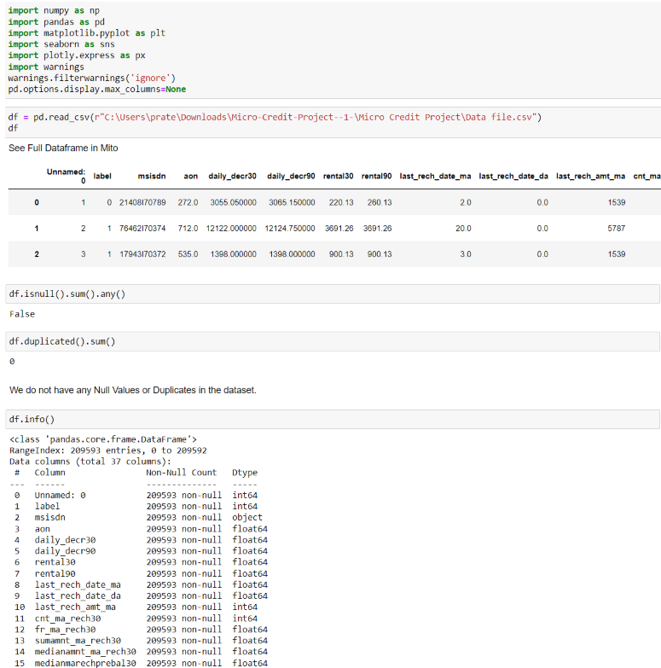
Exploratory Data Analysis
IMPORTING NECESSARY LIBRARIES
LOADING DATASET
SHAPE OF OUR DATASET HAVING 209593 ROWS AND 37 COLUMNS
CHECKING NULL VALUES AND DUPLICATES
CHECKING BASIC INFO

Slide 13
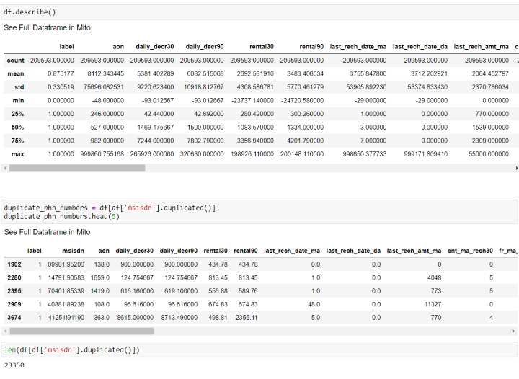
Exploratory Data Analysis
CHECKING STATISTICAL PARAMETERS
REMOVING THE DUPLICATE MOBILE NUMBERS

Slide 14
Visualization

Slide 15
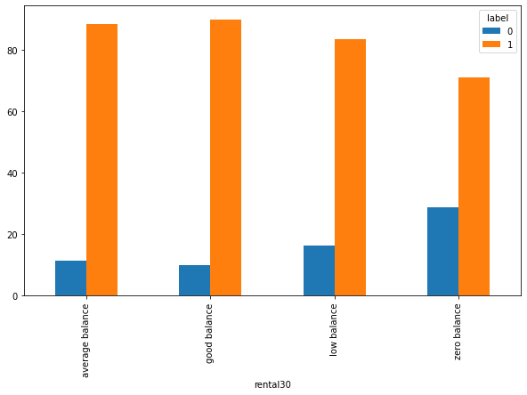
Rental30 vs Label:
We see that the people who maintain good and average balance have a higher chance of paying back the credit amount, were as people with zero balance default the payments the most.

Slide 16
Rental90 vs Label
We see that the people who maintain good and average balance have a higher chance of paying back the credit amount, were as people with zero balance default the payments the most.

Slide 17
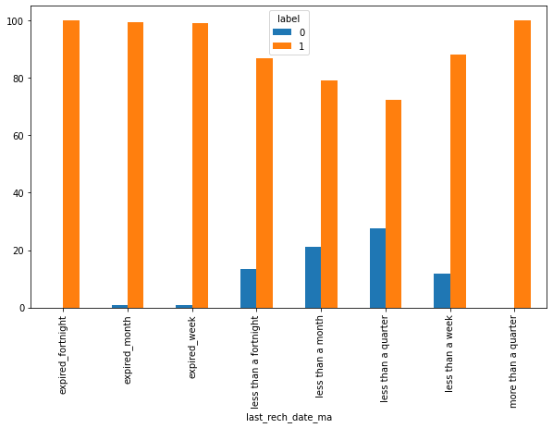
last_rech_date_ma vs Label
we see customers whose accounts are expiring between a week to a quarter are the once who default the payments the most.

Slide 18
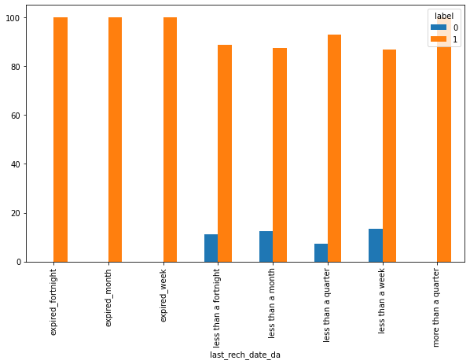
last_rech_date_da vs Label
We see a similar trend as we saw in last_rech_date_ma.

Slide 19
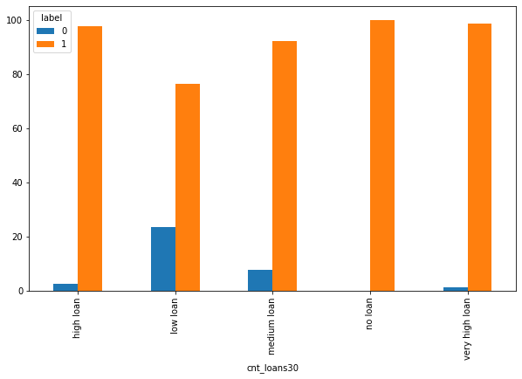
cnt_loans30 vs label
We see that people with low loans tend to default the payments the most.

Slide 20
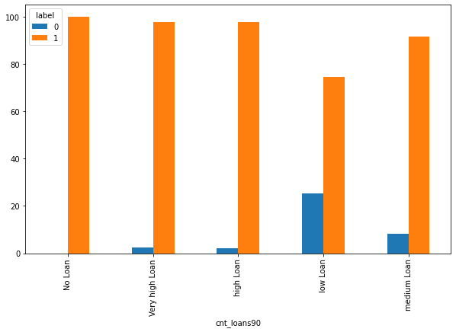
cnt_loans90 vs label
We see a similar trend where in people with low loans tend to default the payments the most.

Slide 21
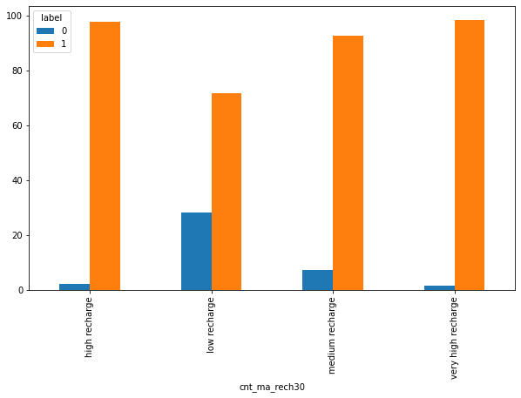
cnt_ma_rech30 vs label
From above, we see that the people who recharge less are the once who default the payments the most.

Slide 22
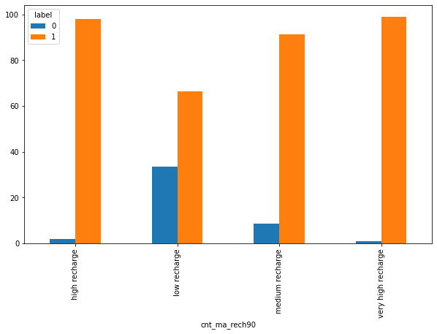
cnt_ma_rech90 vs label
We see a similar trend, where in people who recharge less tend to default the most.

Slide 23
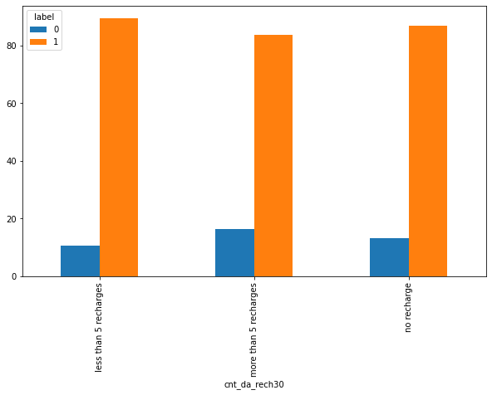
cnt_da_rech30 vs label
We see people with more than 5 recharges tend to default the most.

Slide 24
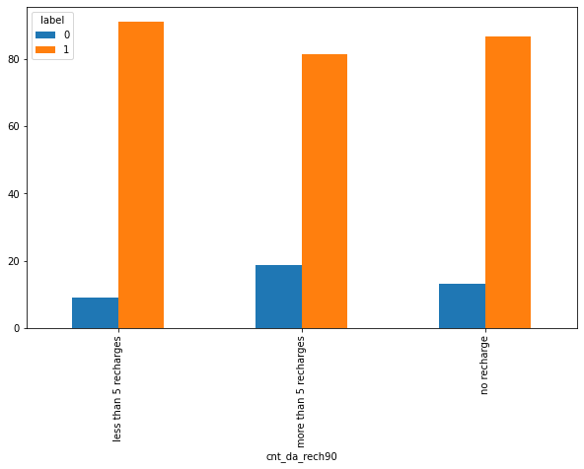
cnt_da_rech90 vs label
We see a similar trend where in people with more than 5 recharges are the once who default the payments the most.

Slide 25
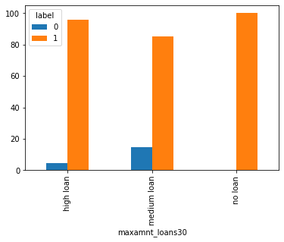
maxamnt_loans30 vs label
We see that the customers who take medium loans are the once, who default the payments most and people who do not take a loan do not default the payments.

Slide 26
maxamnt_loans90 vs label
We see a similar trend where medium loan takers default the payments the most and people with no loans do not.

Slide 27
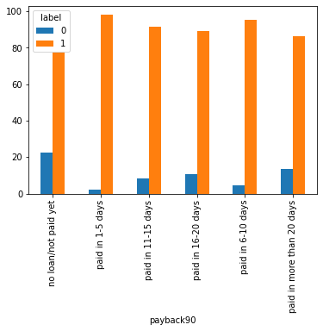
Payback90 vs label
We see people wo pay the loans in 1-5 days tend to default the payments the least.

Slide 28
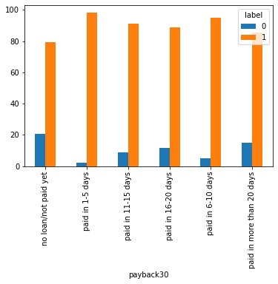
Payback30 vs label
We see a similar trend where in 0 days or no loan/not paid yet contains the highest number of defaulters and paid in 1-5 the least.

Slide 29
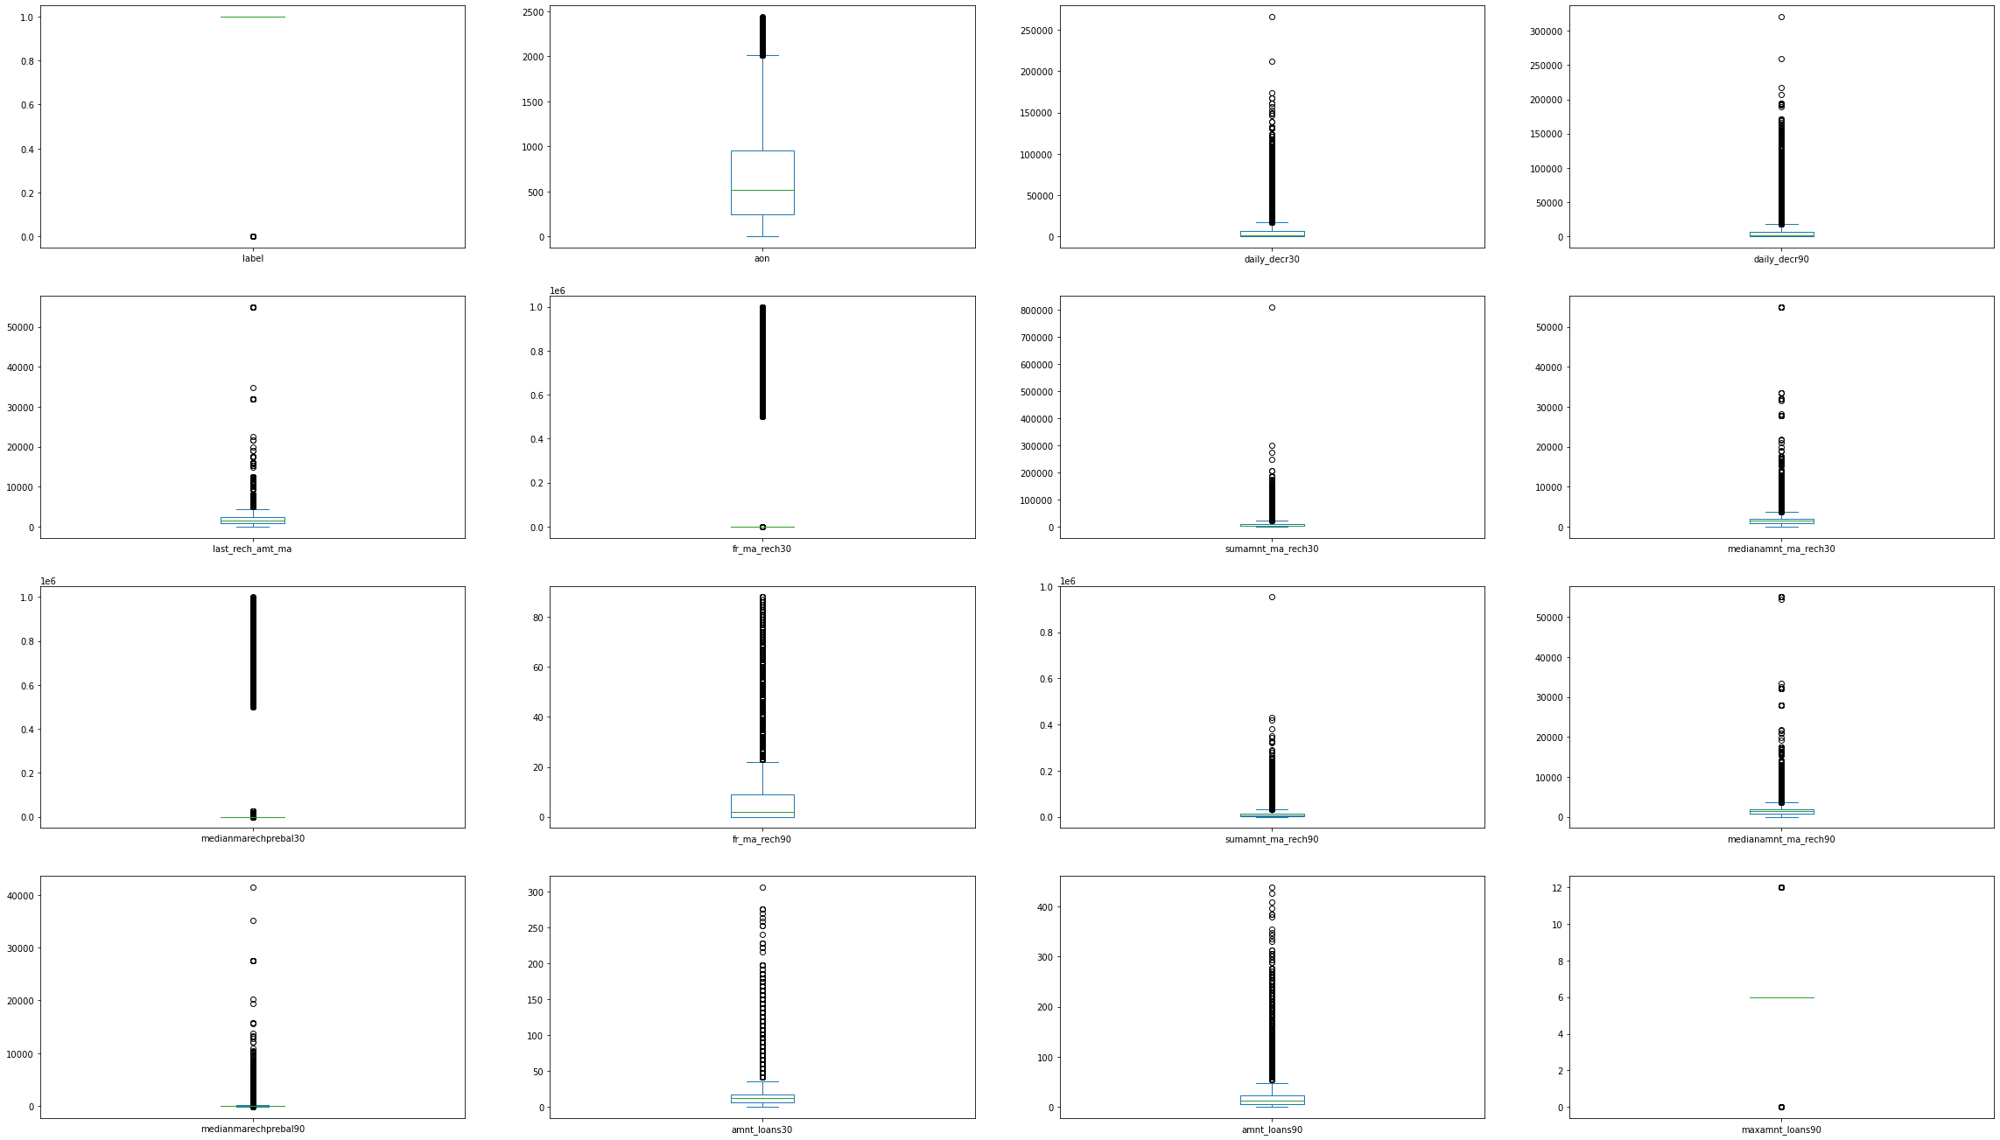
Outliers
We see presence of outliers in almost all the columns and in a huge numbers.

Slide 30
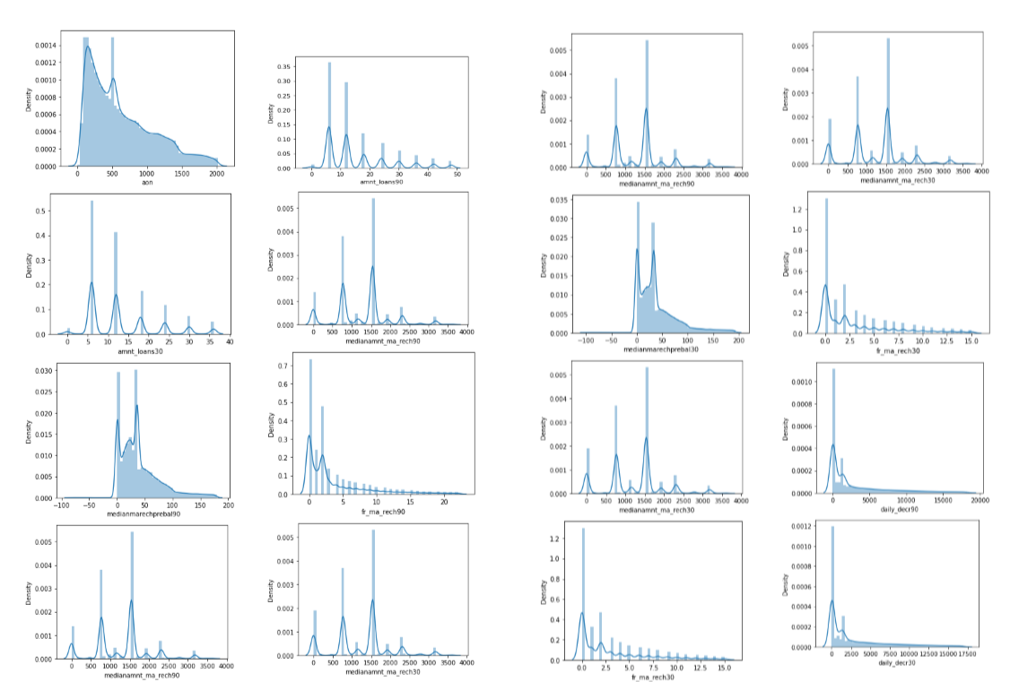
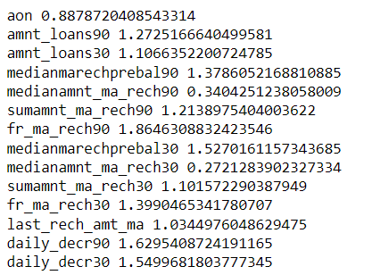
Checking skewness
Almost all the columns have skewness present.

Slide 31
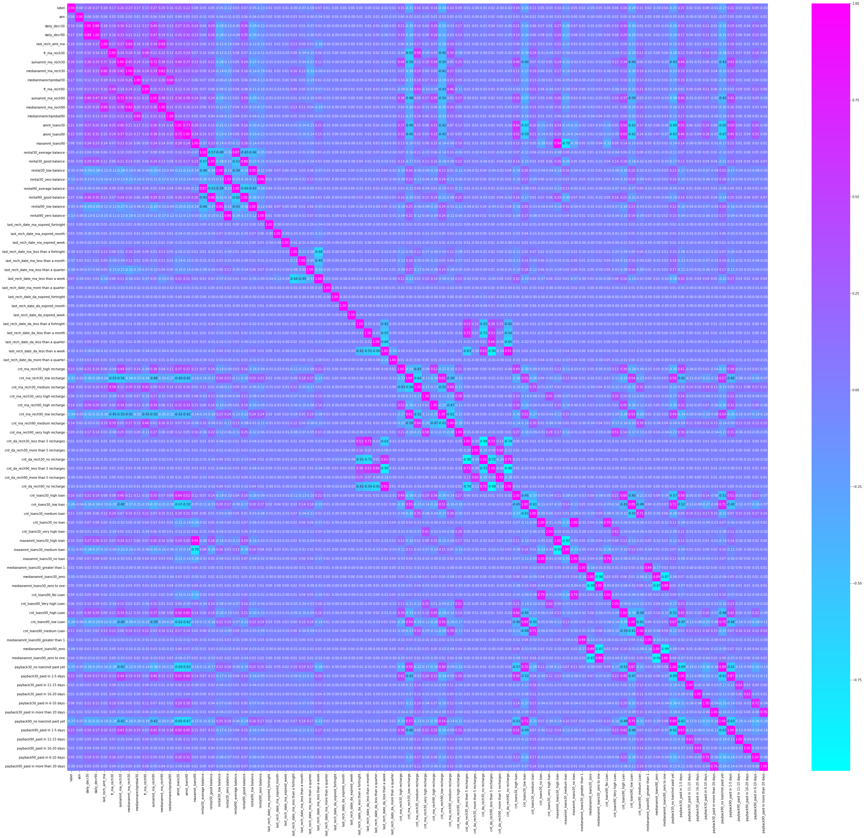
Correlations
We see a strong correlation between a lot of features from above, we would go ahead with dimensionality reduction technique PCA to reduce multicollinearity and reduce the dimensions as well.

Slide 32
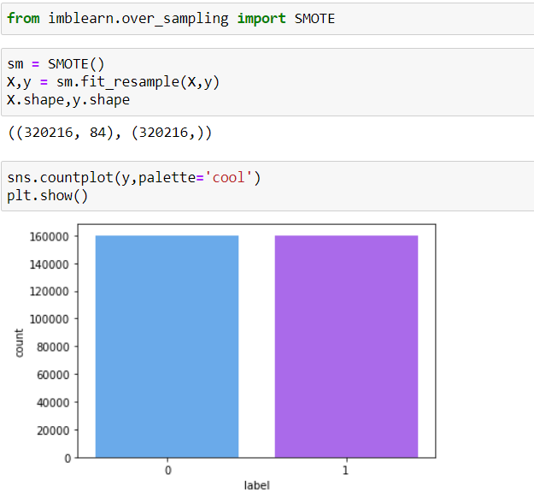
Balancing the data
The dataset is highly imbalanced and we'd have to balance it.

Slide 33
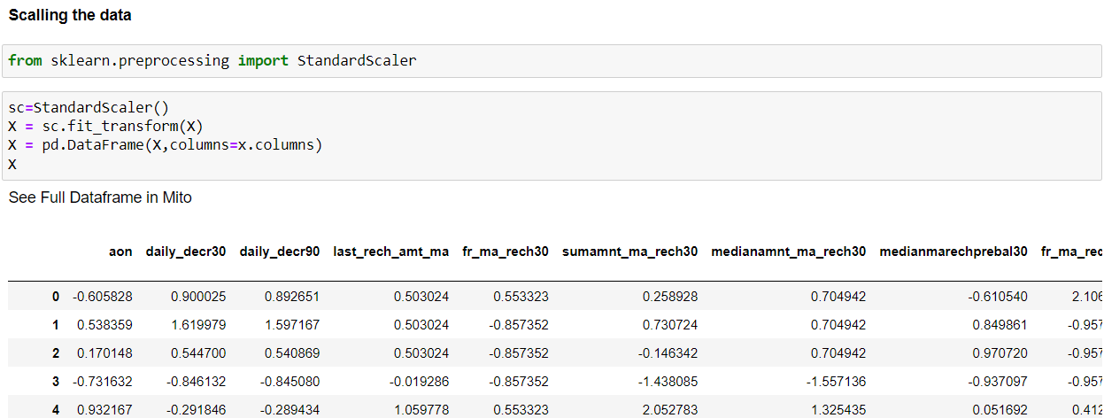
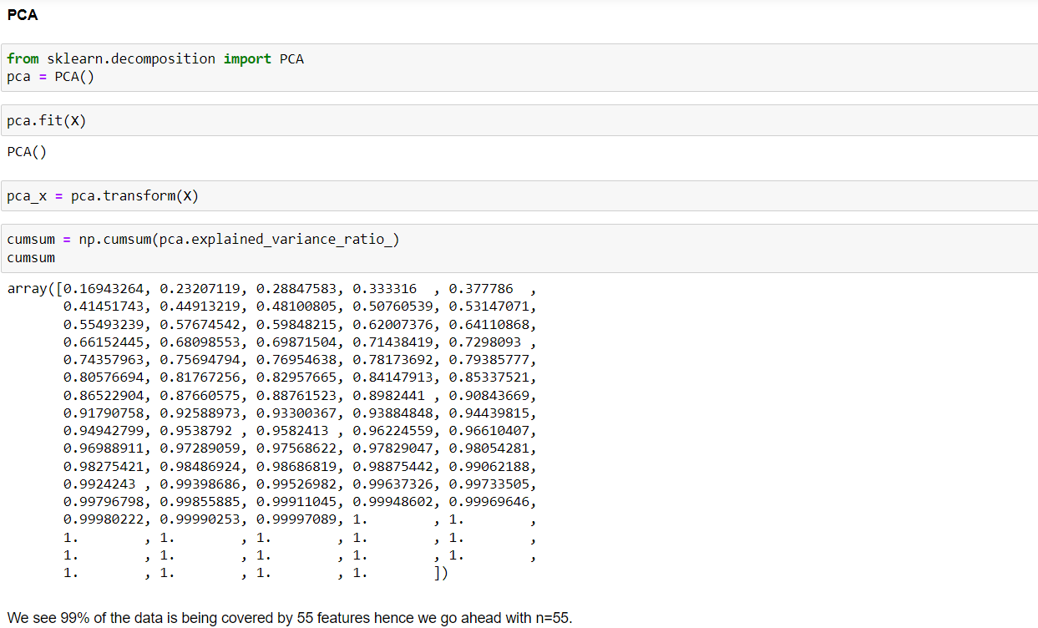
Data Modelling
Scaling the Data
PCA

Slide 34
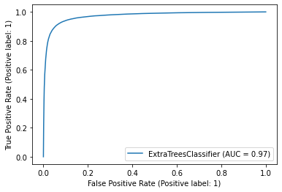
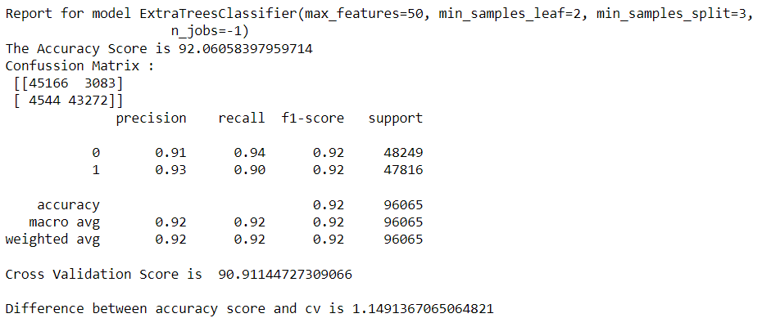
ExtraTreeClassifier :

Slide 35
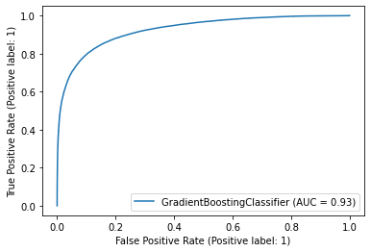
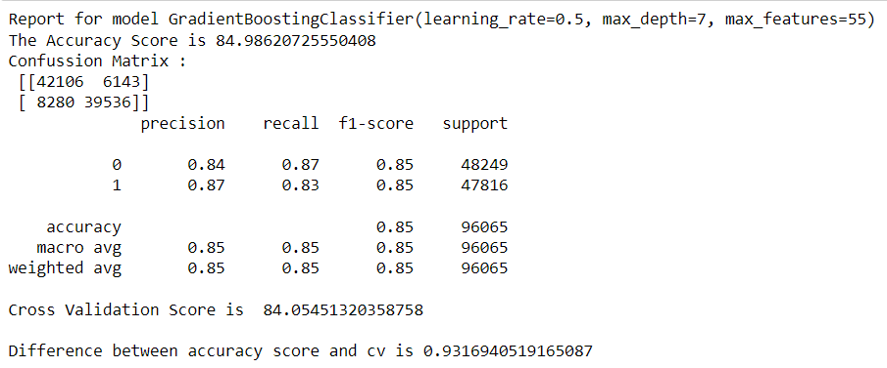
GradientBoostingClassifier :

Slide 36
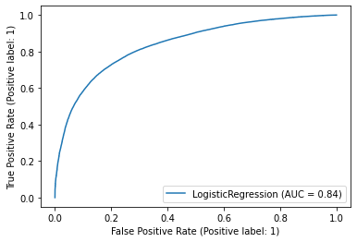
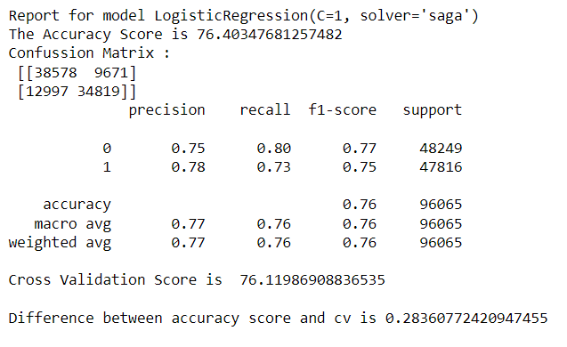
LogisticRegression :

Slide 37
Final Model:
We see that the difference between the accuracy and cv is the least for LogisticRegression but the AUC Score for it is the least.
Hence, we choose ExtraTreesClassifier as our final model where in the difference between the accuracy and cv is higher by about 1% compared to LogisticRegression but it has the highest accuracy and the highest AUC Score. It also has the least false negative or type 2 error.

Slide 38
Thanks

